Slide 1
Meeting for New Parents of Reception Children.
Aberford C of E Primary School
Wednesday 19th June 2019
Teacher Mrs Shaw
Teaching Assistant Miss Haigh

Slide 2
Welcome
This presentation aims to provide an introduction to the Early Years setting.
This year we have 14 children joining our Aberford family.
We look forward to welcoming the children on Thursday 5th September 2019.

Slide 3
First Morning!
Our doors will open for children at 8:45 and you are welcome to come into the setting with your child. You may wish to support them in finding their named coat peg and tray.
Book bags are expected to go into the trays and it is important they are in school each day as home reading books and information will be going home in their bags.
The first few mornings can daunting, but be assured most children settle quickly and are engaged with their surroundings and building relationships. We will of course communicate with yourselves at the end of the day to how your child is settling into school life.

Slide 4
Your Support
We understand and value the support you give your child at home and the staff would love to hear about what you and your child have been doing at home. We encourage you to share your child’s achievements and experiences with staff, as this helps us build a complete picture of your child.
A meeting will be arranged in the Autumn term to provide you with information in using the online journal “Tapestry". This will allow you to share your child’s achievements with their class and staff.
We will also arrange a meeting to discuss the teaching of phonics and the support you can give your child at home.

Slide 5
Nursery Visits
We would love to visit your child at nursery as this will help us to see them interacting with their friends whilst learning.
It will also give us an opportunity to speak to the adults who support your children in the nursery provision.
Please fill in the form indicating which nursery your child attends and importantly on the days they go.

Slide 6
Home Visits
This is for the teachers to see the children in their own surroundings, where they are often much more comfortable.
In September this year, if you wish, we will be visit each child in their own home.
Please sign up if you would like us to visit your child in their home environment.

Slide 7
What will my child need to bring to school?
Named water bottle (water is always available if your child forgets their bottle).
Named wellington boots.
Named sun hat/winter hat.
Named spare socks and pants.
Named coat.
Named outdoor trainers – they will probably get muddy!!
Fruit is available for each child daily.
We have waterproof jackets and trousers for outdoor waterplay and the mud kitchen.
We have spare uniform if your child has an accident or gets carried away with their learning!
We encourage children not to bring toys, but we love stories and topic related artefacts.

Slide 8
Lunchtime
We are fortunate to have fantastic lunch time staff that will be supporting your child in choosing their lunch and encouraging them to try different foods.
Initially Miss Haigh or myself will spend time helping your child at lunchtime and outside on the playground.
When we feel it is appropriately we will allow the lunchtime staff to take on this supporting role.
All children will be provided with a piece of fruit and will have access throughout the day to drinking water.

Slide 9
Reading
Please enjoy reading with your child.
Initially children will come home with books with no words.
This is to encourage comprehension and the routine of looking at a book.
We will continue to send out reading books that will support your child’s reading development.
Please do not feel your child has to look at their reading book every night – at this stage of development we want to encourage the joy of reading.
Please use the reading record book to comment on your child’s reading.
Your child will also be able to choose weekly a library book to enjoy from our lovely library.

Slide 10
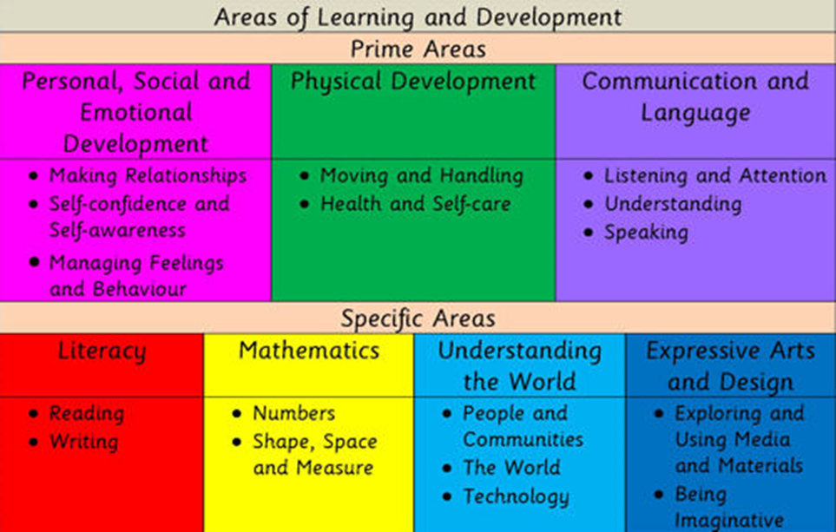
The 7 areas of learning in the Early Years Foundation Stage Assessment. Observations. Next steps.

Slide 11
Development
Children should develop the 3 prime areas of learning first. These prime areas are essential for your child's development and future learning.
Communication and language
Physical development
Personal, social and emotional development.
As the children develop and grow, the prime areas will help the children develop skills in the specific areas.
Literacy
Mathematics
Understanding the world
Expressive arts and design.

Slide 12
Characteristics of Effective Learning
Playing and exploring – children investigate and experience things and “have a go”.
Active learning – children concentrate and keep on trying if they encounter difficulties and enjoy their achievements.
Creativity and thinking critically – children have and develop their own ideas and make links between ideas. They develop strategies for doing things.
Process over outcome.
The process is the learning not the end product!

Slide 13
End of the Day
The day finishes at 3:10pm.
Please stand outside the door in a position that is visible, once Miss Haigh or myself sees you we will call your child to leave with you.

Slide 14
Our Aim
To ignite your child’s love of learning. We will support your child in developing persistence….
We will support your child in developing resilience……
We will support your child in believing in themselves…..
We will support your child in developing self confidence…..

Slide 15
Questions?
Please if you have any questions a member of the Early Years team is here to help.
We are looking forward to September and the happy memories we will be making with your children.

